Slide 1

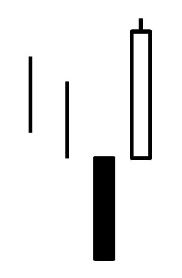
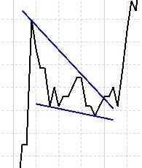
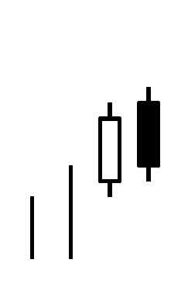
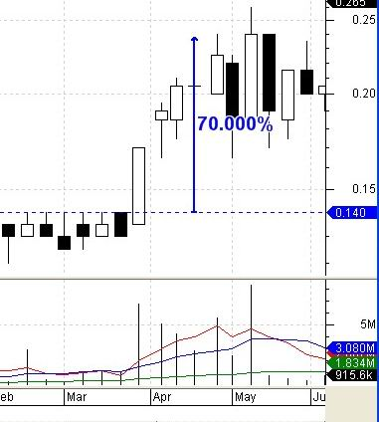
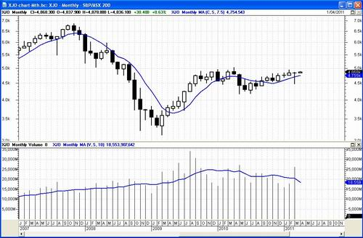
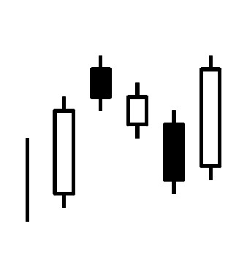
Technical Analysis?
What is it?
How can I profit?
chart
patterns
candlestick
patterns
price
breakout
monthly candle chart
Slides prepared for ATAA use
courtesy of: www.robertbrain.com
© Copyright 2014-2017
Version: 6
Notes:
This presentation
This set of slides is a sub-set of the slides from Robert's 1-day Technical Analysis seminar (which runs in Melbourne for 6 hours, with a handbook of more than 100 pages).
This slide set has been made available to the ATAA for use at the annual Expos, and for display at chapter meetings. Originally prepared in 2010, and updated in August 2014.
This version complete with “speaker notes” in the lower portion of each page are available for Share Market Toolbox (premium) members.

Slide 2


Technical Analysis is very useful!
Financial market price charts
summarise the underlying
opinions and emotions
of market participants.
Every chart tells a story.
It pays to understand the
stories in the price charts.
Notes:
This is so very important
Please take a moment to carefully read the text on this slide. It is very, very important and is the basis for a lot of information on this subject.

Slide 3
Why use technical analysis?
To help understand more about why
prices are moving (opinions and emotions)
Make smart and informed
stock purchase decisions
Minimise downside risks
Maximise upside potential
Make smart sell decisions if needed
Protect hard-earned capital
Minimise any losses.
Notes:
Why use technical analysis?
What are the benefits of using technical analysis?
How can technical analysis help us?
See the key points on the slide above.

Slide 4
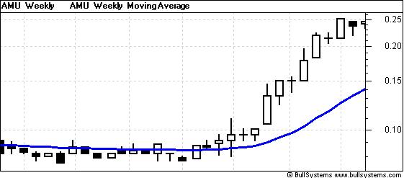
Key price chart observations
Weekly candlesticks
Log price scale
MA chart indicator
Price consolidation
(below resistance)
Break out
Up trend
1
6
2
5
4
3
Notes:
EXAMPLE
On this price chart, note these key features.
Starting at the left side of the chart, we can see that the share price was in a consolidation zone (4) for a period of time — stuck under a resistance level. That is, the market participants had an opinion that basically said “this stock is not worth any more than the top of this resistance zone”.
Then they changed their minds, and the price broke to the up side, and kept on going. This might have been due to significant news.
The Moving Average curve (3) helps show the averages of recent prices.

Slide 5
Disclaimer
CAUTION!!
This presentation contains NO advice.
It is for general education only.
Always consult a trained, trustworthy professional before investing,
to determine if your intended investment
might suit your personal individual situation.
Notes:
DISCLAIMER
As normal with these presentations, there is no recommendation to take any action, nor any suggestion that the information herein might be profitable.
If you take some action based on the material herein, and it is profitable, then well done. If you lose some money, you just need to remember that we did say there is no recommendation for action here — it is purely for education.
Remember that technical analysis is not a precise science as it involves interpreting herd behaviour and the like, and this is not totally predictable (more on this later).

Slide 6
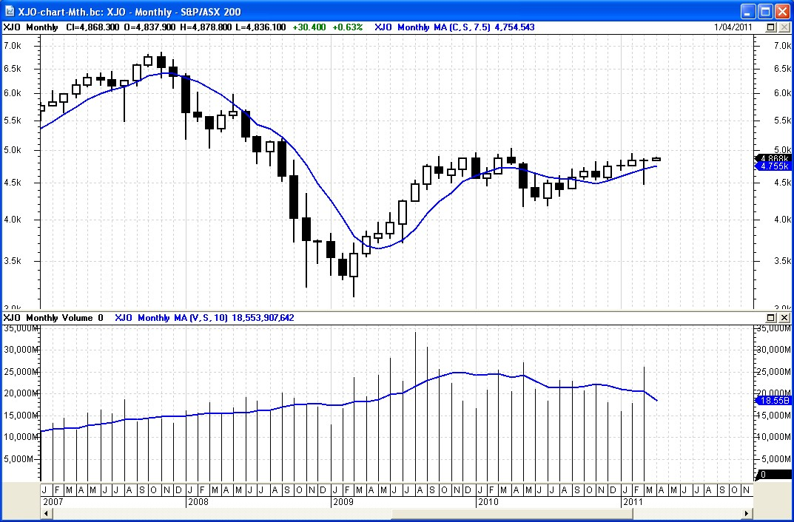
T.A. — One accepted definition
The use of market data
(and charting skills)
to anticipate market direction
and timing
to make consistent profits.
Notes:
DEFINITION
There are several definitions for technical analysis, and they are all somewhat similar.
This is one accepted version.

Slide 7
T.A. is a very broad field
Price charts and chart patterns
Candlestick (or bar) charts and patterns
Chart Indicators
  Moving Average, MACD, RSI, P-SAR, etc.
Numeric (computational) analysis
Specialist topics:
  Fibonacci, Elliott Wave, W.D.Gann
Using charting software
Notes:
Beginners take note!!
For many people, when they start out learning about technical analysis, it can take in the order of 2 to 4 years to “discover” all the different aspects of technical analysis.
This slide summarises the major areas that comprise the subject. Each of these tends to comprise many sub-topics.
The challenge for people who are new to technical analysis is to understand the broad subject and then focus on the sub-topics that seem to be of interest. Because not all of them will be of interest.

Slide 8
Introductory comment
Technical Analysis (T.A) can be used on:
  company share price charts
  charts of a market index
  commodity price charts
  foreign currency (forex) charts
Notes:
Two important notes (as on the slide)
A comment on note 2:- Technical analysis is based on the interpretation of price charts, which themselves summarise the opinions of market participants. As this is a reflection of the behaviours of the market participants, it can't be a 100% accurate science.
HOWEVER, technical analysis is accurate enough so that proponents will be a long way ahead of the average investor in understanding the likely price movements ahead.
(When this proponent first learnt about it, he thought that it was a black science — like witchcraft — and unfair on others; but quickly changed this view.)

Slide 9
Introductory comment
Technical analysis (T.A) can be used on:
  company share price charts
  charts of a market index
  commodity price charts
  foreign currency (forex) charts
Technical analysis is very good; but
not 100% guaranteed, nor 100% reliable
Notes:
Two important notes (as on the slide)
A comment on note 2:- Technical analysis is based on the interpretation of price charts, which themselves summarise the opinions of market participants. As this is a reflection of the behaviours of the market participants, it can't be a 100% accurate science.
HOWEVER, technical analysis is accurate enough so that proponents will be a long way ahead of the average investor in understanding the likely price movements ahead.
(When this proponent first learnt about it, he thought that it was a black science — like witchcraft — and unfair on others; but quickly changed this view.)

Slide 10

Introductory comment
Technical analysis (T.A) can be used on:
  company share price charts
  commodity price charts
  foreign currency (forex) charts
T.A is very good; but
not 100% guaranteed, nor 100% reliable
Using T.A can give an unfair advantage
over the buy-and-hold investors.
Also need to use wise money management and risk management principles.
Notes:
Important notes — more comment
On the previous slide (in the notes) we said that proponents of technical analysis will be ahead of other investors. It could be argued that this is an unfair advantage; but then this information and knowledge is readily available to all those who care to study it.
The other point that must be emphasised is that wise money and risk management principles go hand in hand with success using technical analysis. Without sound money and risk management, a winner will be accidental.

Slide 11
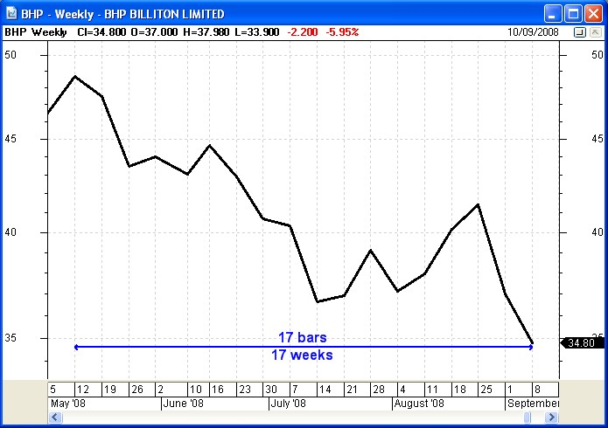
The Weekly Line Chart
Shows the Closing price
at the end of each week,
joined together by
short straight lines.
A downtrend is
likely to continue
(like catching a falling knife)
A weekly chart can cover any period in time.
This one is 4 months.
Notes:
The Weekly line chart
This is very common, and it is important to understand what it shows us — the close price each week, all joined together with short straight line segments. It does NOT give any indication of the range in price during the week — which might have been extreme.
This particular example also shows that from the top left corner to the bottom right corner we can see a series of “lower peaks” and “lower troughs”, which constitute a down trend. Dow Theory basically says that once a trend is in place, it is likely to continue, and we should consider it is still under way until it is confirmed to have finished. That is, if you buy a falling stock, don't be surprised if it continues falling!

Slide 12
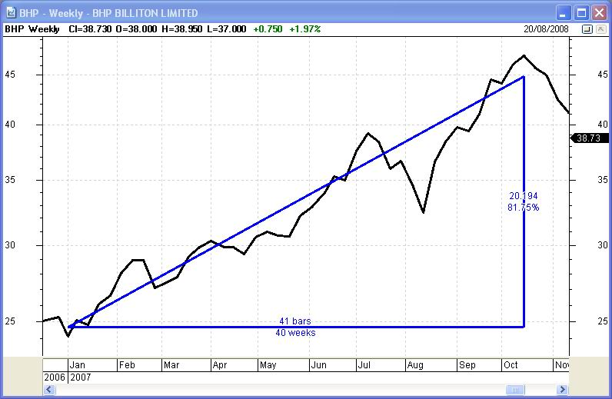
Uptrends
Could you have been tempted to buy this stock?
If only we could
spot these uptrends
and take profits.
Up 81% in
40 weeks.
A weekly line chart of BHP
over 10 weeks
Notes:
The up trend
Here is a sample up trend on a weekly line chart of BHP. And we can see it rose some 81 percent over 40 weeks.
These are the types of trends that are useful to identify very early in the piece, so that we can buy into the stock and ride the trend for as long as it continues.

Slide 13
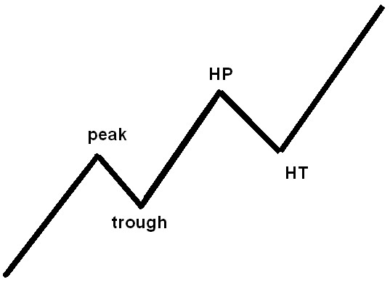
Defining a trend — it's simple
Identify the Peaks and Troughs.
Look for:
Higher Peaks (HP) and
Higher Troughs (HT)
(or Higher Highs and
Higher Lows).
Notes:
How to define a “trend”?
In technical analysis terms, an up trend is defined as a series of:
higher peaks (or higher highs), and
higher troughs (or higher lows).
This is a very basic principle that is very often referred to in technical analysis. It is so very useful to understand this.

Slide 14
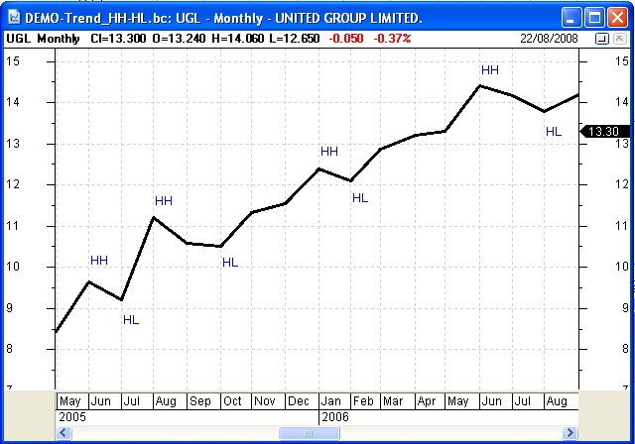
uptrend = Higher Peaks and Troughs
Get a feel for what
the price is doing.
Identify trends
uptrend, or
down trend, or
non-trending.
Use chart indicators
to help.
Terminology:-
Higher High = Higher Peak
Higher Low = Higher Trough
Notes:
Sample chart
Here is a sample monthly chart of United Group (UGL) in 2005 and 2006. It shows it's fantastic price uptrend over a 16 month period.
The monthly price chart is similar to the weekly, except that it shows the close price at the end of each calendar month (and it gives no indication of the price movement during the month).

Slide 15

uptrend = Higher Peaks and Troughs
“The trend is
your friend”
Once in place, an
uptrend is likely
to continue.
Join the trend
until it has finished.
Terminology:-
Higher High = Higher Peak
Higher Low = Higher Trough
Notes:
Sample chart — continuing comment
A long term investor who looked at this chart in 2005 might have spotted this up trend, and bought the stock, and held it until the trend finished.
We know that once a trend is confirmed, then it is likely to continue (because of herd mentality, and the opinions of the majority of the market participants).
At some point the trend might finish — again due to the opinions of the majority of market participants. And technical analysis helps us to identify when the trend might be weakening, and when it has finished.

Slide 16
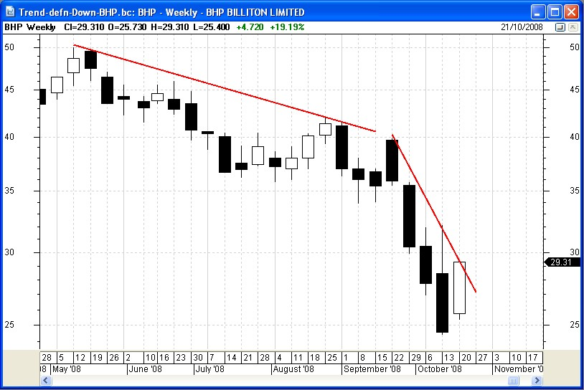
Beware the downtrend
Not a good idea to invest
in a down-trending stock,
until the trend has finished.*
* based on the principles of Dow Theory
Notes:
Beware! the down trend
We said earlier that once a trend is in place, it is likely to continue. This applies to both up trends, and down trends (a down trend is a series of lower peaks and lower troughs).
This chart is a great example of what can happen to a minor down trend — it can turn into an overwhelmingly sharper down trend.
Some advisors say: “buy while it is cheap”. But what they don't say is: “beware, because it might get even cheaper”. They use the “excuse” of dollar cost averaging — which is very dangerous, because some blue chips get cheaper and cheaper, then liquidate and take all shareholder funds.

Slide 17
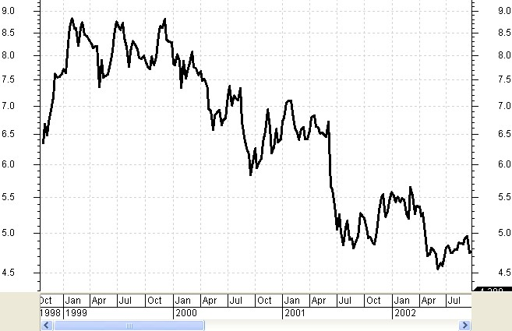
Down Trends
Might you have been
tempted to buy this
(down-trending) stock?
A weekly line chart of Telstra, 1999-2002 (down 46%).
Both government and advisers were recommending to buy each tranche — T1, T2, T3.
(Could argue that was criminal)
Notes:
In hindsight, was it a good idea to buy Telstra?
This is the weekly chart of Telstra since it floated with the T1 IPO in 1999, and during the period of subsequent public float tranches — T2 and T3.
With hindsight we can see the down trend.
But at the time both the government and many financial advisers recommended that the public take up the public offer and buy the shares. If only everyone knew then what they now know.

Slide 18
These slides can be
emailed to you.
Please leave
your details
(or send us an email).
Notes:
For anyone viewing these slides at the annual Expo events, or at an ATAA Chapter meeting, this set of slides can be emailed to you (as well as notification of upcoming ATAA meetings and events).

Slide 19
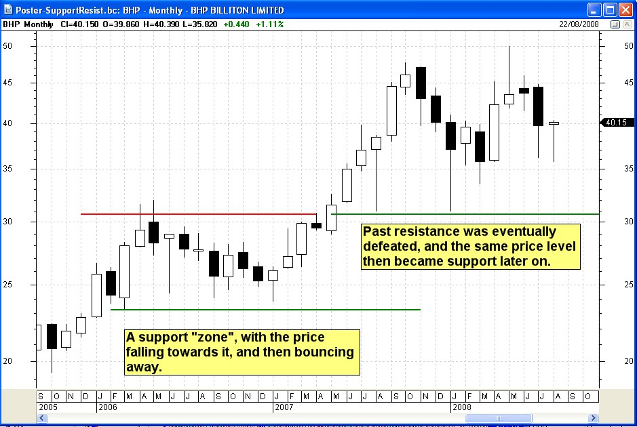
Price Support and Resistance
Support lines
Resistance line
Note: Sometimes a
“fat pencil” is appropriate
especially on monthly or
weekly price charts.
Notes:
Support and Resistance
These two notions are very very important principles of technical analysis.
These horizontal lines tell us about the opinions of the majority of the market participants.
More information on the next page...

Slide 20
Price resistance — HOW SO?
In 2006, the majority of
market participants
had an opinion:
“BHP is worth more than $23; but not worth more than about $31”
Remember:
There is no point trying to argue with “Mr. Market”!
$30
$23
$23
Resistance line
Notes:
Resistance — How does it work?
The resistance line on this monthly chart of BHP indicates that the majority of market participants who bought or sold BHP shares in 2006 had an opinion that they were not worth more than about $31. When the price reached this level, the sellers dominated, overwhelmed the buyers, and the price fell away.
Conversely, they thought that the shares were worth more than about $23-$24, resulting in a support line on the chart through the same period.
REMEMBER: There is no point trying to argue with “Mister Market” (ie. the majority of market participants), because he will win every time.

Slide 21
Price support — HOW SO?
From April 2007, their opinions changed:
“BHP is now worth more than $30”
$30
There is no point
trying to argue with
“Mr. Market”!
$23
$23
Support line
Notes:
Support — How does it work?
If the market participants held an opinion in 2006 that BHP was not worth more than about $30 to $31, then at some point they changed their mind, and into 2007 their new opinion was:
“it is now worth more than $30 to $31”.
This price level became a support level going forward. In the following months, whenever the price fell to this level the buyers stepped in to snap up what they thought was a bargain.

Slide 22
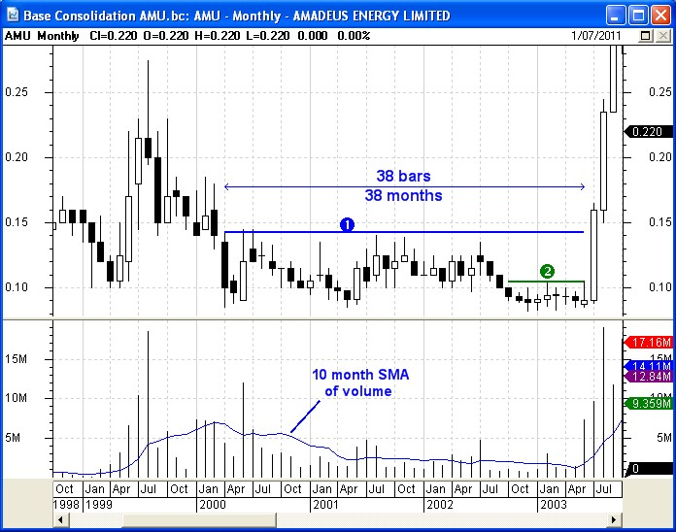
Chart patterns
Base Consolidation
For 38 months, market
participants had an opinion:
“This stock is worth
more than 8 cents
but less than 14 cents.”
So, price was stuck
under “resistance” …
Notes:
Another basic chart feature
This is another basic concept in technical analysis.
Which is not that different from the notions of price support and resistance.
This chart shows a period in time where this share price was stuck in a trading range, during which time sellers were so dominant that they stopped the price from rising above about 14 cents. These opinions, and their selling in the market, lasted for more than 3 years.
When this appears after the period of higher prices at the start of this chart, we refer to this consolidation period as a base consolidation.

Slide 23
Chart patterns
Base Consolidation
...price was stuck
under “resistance”
until July 2003,
then opinion changed
and price broke
above resistance
with a Big White candle
and much higher volume.
Notes:
Base consolidation
Eventually, in June 2003 there was a change in opinion which triggered a massive new up trend, and the consolidation period was over.

Slide 24
Chart patterns
The Bullish
Falling Wedge
chart pattern
QUESTION:
How can you explain
this price chart?
What were the
market participants
really thinking?
Price support?
Notes:
Chart patterns
The broad range of chart patterns is another major aspect of technical analysis. We can often draw straight line segments on a price chart which “contain” the price action, and give us clues about the opinions of the market participants.
There are many different types and shapes of chart patterns. This Bullish Falling Wedge pattern is just one.
See the next slide for a discussion...

Slide 25
Chart patterns
The Bullish
Falling Wedge
chart pattern
Price rose too far too fast.
Then fell for a period of time to “balance out” the progress.
Then price continued the earlier uptrend rally.
Notes:
Falling Wedge pattern
This pattern tends to happen when the share price races ahead too far, in too short a time period.
This results in investors taking profits because the price has run ahead of their view about a “fair price”. So the price retreats.
At some point the price becomes “over sold”, at the bottom end of the price range that investors believe is “fair”, and they buy in again.
When you step back and view the big picture version of this pattern, it is apparent that the price ended up at a reasonable price level over the total time period. That is, what we call “price and time in balance”.

Slide 26
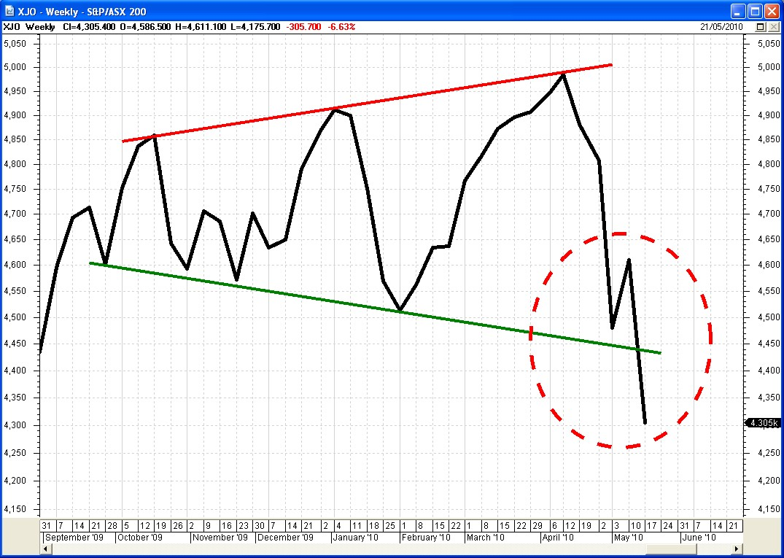
The Expanding Wedge
(megaphone)
chart pattern
Price was volatile in a widening band for
6 months.
The bulls and bears pulled up/down, then the bears won
Price collapsed below
the 6-month price support level
Notes:
Megaphone — Another chart pattern
The two straight lines that “contain” the price action on this price chart form what we call an Expanding Wedge chart pattern (or Megaphone).
It shows us that the buyers and sellers had increasingly different opinions about fair value, pulling the share price higher and higher, and lower and lower. Eventually, the sellers won this battle and the price fell below the past support level.
In this example the lower boundary was basically a support level, but not a horizontal line. The majority of market participants were slowly changing their opinion about the lower support level, causing it to decrease over time.

Slide 27
These slides can be
emailed to you.
Please leave
your details
(or send us an email).
Notes:
For anyone viewing these slides at the annual Expo events, or at an ATAA Chapter meeting, this set of slides can be emailed to you (as well as notification of upcoming ATAA meetings and events).

Slide 28
Bars and Candles
The bars and
the candles
on a price chart
tell us a lot about
the opinions of the
market participants.
(do you know how?)
Notes:
Candlesticks and bars
The price charts included earlier in these slides have all been line charts. These charts show the close price at the end of each period (which could be a day on a daily chart, or a week on a weekly chart, or a month on a monthly chart, etc.).
The line charts do NOT give any indication of the range in price during each period.
However, the bars on a bar chart, and the candlesticks on a candle chart, do show the range in price during each period.

Slide 29
OHLC Bar and Candle...
Each bar on a
bar chart, and
each candle on
a candle chart
summarises the
price action
in any one period
(a day, week, month, etc.).
Notes:
Bars versus candles
The single OHLC (Open-High-Low-Close) bar shown at left on this slide and the candle shown at right both tell us the same thing about the range in price during a period. They both show:
Open price
High price
Low price, and
Close price.
Some people prefer bars, and others prefer candles. This analyst's observations are that those people who learnt technical analysis many years ago grew up using bars and prefer bars, while those who are newer to technical analysis in recent years prefer candles (because, they claim, it is easier to quickly interpret a chart with many candles — and I agree).

Slide 30
Candlestick features — the White candle
“high” price
for the period
(top of candle tail)
“open” price
for the period
(bottom of candle body)
“close” price
for the period
(top of candle body)
“low” price
for the period
(bottom of candle tail)
A “period” is a
day, week, month, etc.
Notes:
The white candlestick
Candles can have a candle body, and they can have one or two tails (or no tails). The tails can also be called wicks, or shadows.
Note the key features of a white candle in the diagram on the slide.

Slide 31
Candlestick features — the Black candle
“high” price
for the period
(top of candle tail)
“open” price
for the period
(bottom of candle body)
“close” price
for the period
(top of candle body)
“low” price
for the period
(bottom of candle tail)
A “period” is a
day, week, month, etc.
Notes:
The black candlestick
Note the key features of a black candle.
The only difference to the white candle is that the open and close prices are reversed.
How to remember which is which? — The colour black is often associated with doom and gloom, so a black candle indicates a period where the price fell during the period, so the close is lower than the open.

Slide 32
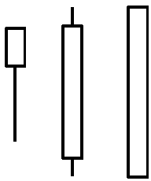
Candle body and tails
Their presence or absence is important
Their length (ie. their height) is important.
For example:
This long lower tail
shows the presence
of sellers in the “period”,
who were “defeated” by
the buyers at the close
of the period.
Notes:
Candle bodies and tails
When studying the candles on a price chart it is useful to observe the size of the candle body — long, short, or tiny — and the presence or absence of any tails.
See the comment on the slide which indicates the story behind a long lower tail. (Remember that the price charts contain stories that reflect that opinions and emotions of the market participants.)

Slide 33






Candle patterns — small bodies
With or without a gap from previous candle.
Hanging Man (at tops)
Shooting Star (2-candle pattern)
Evening Star (3-candle pattern)
Doji Star (2-candle pattern)
Hammer (at bottoms)
Morning Star (3-candle pattern)
These candle patterns
all tell a story.
Can you read the story?
Notes:
Candlestick patterns
Some of the single candles have specific names (such as the Hanging Man and Hammer shown on this slide — the difference between these two is that one occurs at market tops, and the other at market bottoms).
Some specific combinations of two or more candles are distinctive and also have names. See some samples on this slide, and the following slides.
Often, the mood of the market participants becomes clearer when we look at a couple of candles together, because the opinions and emotions can run across multiple days (or weeks).

Slide 34


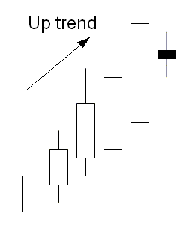
Patterns — engulfing and piercing
Reversal patterns in UP Trends:-
Engulfing Bearish — “outside day”
(2-candle pattern)
Dark Cloud
(2-candle pattern in uptrend)
Harami Bearish (2-candle pattern)
These candle patterns
all tell a story.
Can you read the story?
Notes:
Candle patterns
Some candle patterns are more meaningful when appearing in an up trend.
The term engulfing refers to a candle which literally engulfs the previous candle (rather bearish in an uptrend, indicating a strong reversal of opinions of the market participants).
The term piercing refers to a candle that has opened beyond the price range of the previous one, and which closes back within the body of the previous one — that is, it literally “pierces” the previous day's price range (not as bearish as the engulfing pattern).

Slide 35


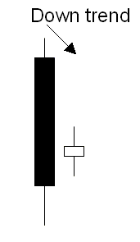
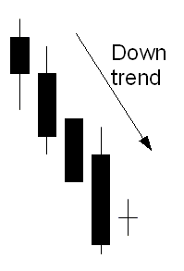
Patterns — engulfing and piercing
Reversal patterns in DOWN Trends:-
Piercing Line (2-candle pattern)
Engulfing Bullish (2-candle pattern)
Harami Bullish — “inside day”
(2-candle pattern)
Harami Cross (2-candle pattern)
These candle patterns
all tell a story.
Can you read the story?
Notes:
Candle patterns
Some candle patterns are more meaningful when appearing in a down trend (where they are bullish).
Again, some patterns can be classified as engulfing, or piercing.

Slide 36
These slides can be
emailed to you.
Please leave
your details
(or send us an email).
Notes:
For anyone viewing these slides at the annual Expo events, or at an ATAA Chapter meeting, this set of slides can be emailed to you (as well as notification of upcoming ATAA meetings and events).

Slide 37
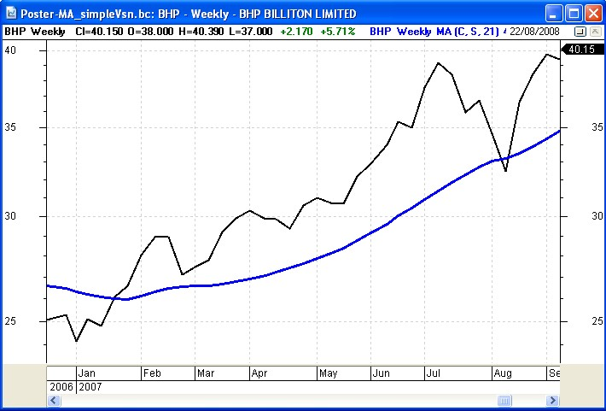
Moving Average (MA)
Is one of many chart indicators.
Very useful
Can help us to
understand the
presence or absence
of a trend, and
perhaps the
strength of the trend
An uptrend
indicates a dominance of buyers.
Notes:
Chart indicators — Moving Average
In the subject of technical analysis there are many different chart indicators. The most basic, and most common, of which is the Moving Average.
The price chart shown here is a weekly chart, showing the close price each week. The blue curved line is the Moving Average indicator (often abbreviated to just: MA). You might be able to see that the MA gives an indication of the “average” close price over many of the preceding weeks.
Note the statements on the slide, and see the comments and notes on the next couple of slides.

Slide 38
Moving Average (MA)
The 21 week MA is the average of all prices for the previous 21 weeks*
Can indicate a trend
Can be used to interpret buy/sell signals.
* - Can be used:
on a daily chart, or
a weekly chart, or
a monthly chart, etc., etc.
Notes:
Moving Average example
By way of example, this chart shows a 21 week MA.
On this chart, at any point along the blue MA curve, the price value at that point of the curve is the average of the 21 previous weekly close prices.
While the MA curve is rising, it is telling us that the share price in recent weeks is tending to move higher and higher.

Slide 39
Moving Average — how to calculate?
Simple calculation of
3-period MA.
The first MA value is
the average of the
first 3 price values:
$\frac{\left(4+5+6\right)}{3} = \frac{15}{3} =5$
Notes:
MA — how to calculate?
For anyone who is keen to understand exactly how the MA is calculated, this simplified example shows how.
Note that this is referred to as a Simple MA, because the price values are simply added up and divided by the total number of values.
There are other variations of the MA in common use, including: Exponential MA, Weighted MA, plus others.

Slide 40
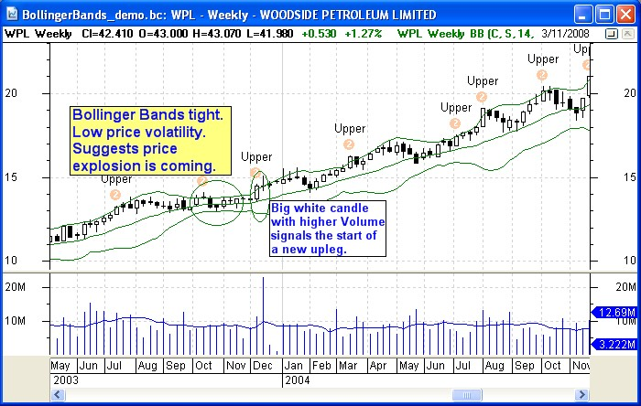
Bollinger Bands indicator
Comprises 3 lines:
a top line,
an average line
and a bottom line.
Weekly
candle chart
Notes:
Bollinger Bands
Just one of the many other technical analysis chart indicators is the Bollinger Bands.
Shown on this sample chart, it comprises three curves as indicated on the slide.
Like many of the chart indicators, there are a multitude of conclusions that can be drawn from the Bollinger Bands indicator (but not discussed here).

Slide 41
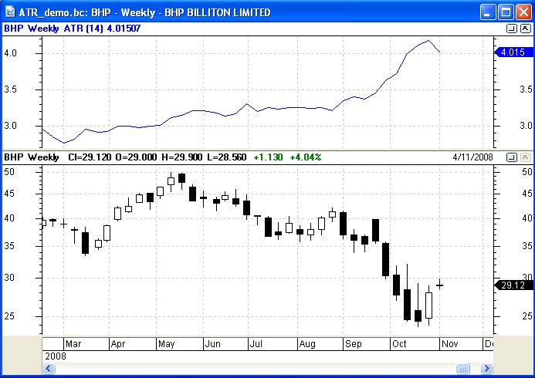
Average True Range (ATR) indicator
Useful to understand the notion of ATR
ATR indicator
This example shows the average variation in price over the
last 14 candles (weeks).
volatility
has increased
~ $3.20
Weekly candles
Notes:
Average True Range (ATR)
The ATR chart indicator is yet another indicator. But whilst the ATR itself is not often used as an indicator, it is used as the basis for other indicators.
In this sample, the ATR has been calculated over the last 14 weeks, and indicates the range in price each week, averaged over the previous 14 weeks.
It is useful to note that the ATR value was around $3.20 across the middle of the chart, and increased towards the right end of the chart — indicating an increase in volatility. This is confirmed with the share price falling quickly over the same period. In this case the ATR itself might be telling us the obvious, but it's numeric value has some uses (see a later slide).

Slide 42
These slides can be
emailed to you.
Please leave
your details
(or send us an email).
Notes:
For anyone viewing these slides at the annual Expo events, or at an ATAA Chapter meeting, this set of slides can be emailed to you (as well as notification of upcoming ATAA meetings and events).

Slide 43
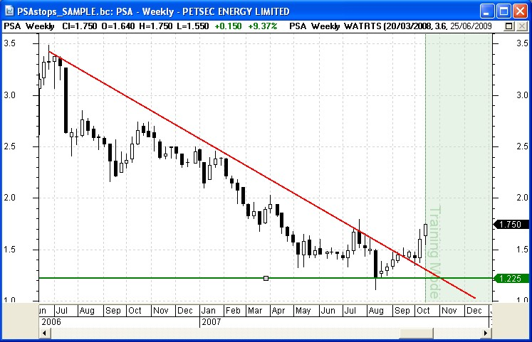
Protecting profit and capital — Stop Loss
Sound and sensible
money management
Have a pre-planned
exit strategy.
Utilise a Stop Loss
to protect capital,
and minimise losses.
Notes:
Protecting our capital
Sound money management, and risk management, is needed to help increase the chances of success.
Although this is not technically a part of the subject of technical analysis, it is an integral part of what a successful investor and trader will do in order to succeed.
These items include consideration of an effective
Exit Strategy, which in its simplest form might include a basic Stop Loss strategy.

Slide 44
Sensible money management
Protect hard-earned capital
Capture and maximise the profits
Minimise losses
Notes:
Why not buy and hold?
These days it is important to use sensible money management and risk management principles. Then we can minimise any losses.
The old principle of buy and hold is clearly out of date, and can now be seen for what it is — a blatant attempt by (large) fund managers to keep our money invested in their own managed fund to help maximise the ridiculous management fees that they receive regardless of whether the fund value increases or decreases.
[You might sense a degree of scepticism and sarcasm here; due to being burnt by a financial adviser and several fund managers in the infamous stock market crash of 1987.]

Slide 45
Stop Loss? — under Support?
Initial Stop Loss position
could be under recent support and under
recent price action.
Down trend is “broken”.
A new up trend
might have started.
Notes:
Sample
In this example, we have spotted a stock with a falling share price which now appears to have bottomed and could be in a new up trend. If so, where might we place our Stop Loss?
Well, it could be under recent price support. But that is just one of many possibilities. When studying technical analysis in more detail, we learn of the other possibilities.

Slide 46
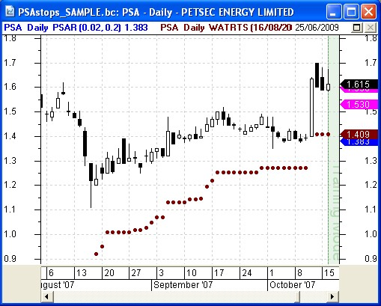
Stop Loss — eg. using ATR
Wilson ATR Trailing Stop indicator
ATR = Average True Range
The stop is set at a multiple of ATR
The Wilson ATR Trailing Stop is a series of dots (like P-SAR) and says: “if the price falls to here tomorrow, then sell”.
Notes:
One sample Stop Loss approach
The Wilson ATR Trailing Stop is one approach that can be used to determine a good price level for our trailing stop loss.
It uses the ATR that we discuss in an earlier slide (Average True Range). The idea here is that for as long the price stays within a reasonable range of the recent prices, then any up trend is likely to continue. But as soon as the price moves a lot further downward than any recent price range, then perhaps the up trend is over.
One measure of this is the ATR, and with this chart indicator we can apply a series of rising dots across the chart which are something like 2 times, or 3 times the recent average of prices (ie. 2 times the ATR value).

Slide 47
Sample Trading Strategies
Find stocks using fundamental analysis and
time entry with technical analysis
High dividend yield
Long term bull market strategy, different to:
Shorter term bull market strategy
Different for a bear market.
Momentum indicator + MA-of-Momentum
(see next slide)
Notes:
Sample trading strategies
Just by way of example, here is a short list of some possible trading / investing strategies (none of which are guaranteed! — we have to say that).
For more details on any of these, you will need to do a little research.

Slide 48
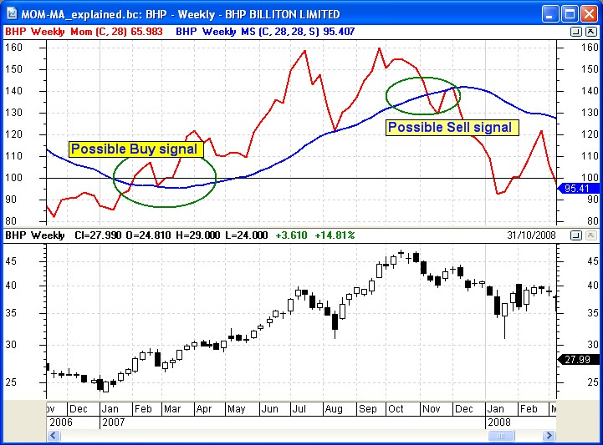
Sample Strategies
Momentum indicator
and
MA-of-Momentum
Notes:
Momentum and MA of Momentum
The Momentum chart indicator is another popular indicator, along with the Moving Average of Momentum. On this sample chart the red line is the Momentum and the blue line is the MA of Momentum.
The rising MA of Momentum is bullish, and some people would view the cross-over of these two as a potential buy signal, or sell signal, as indicated on the sample chart.

Slide 49
More sample strategies*
Use ADX chart indicator for entry
(refer Chuck le Beau)
Use Parabolic SAR for exits
Price Breakout
(see next slide)
* — There is no guarantee of success with any published strategies.
X
Notes:
More sample strategies
Here are a couple more samples for you to research.

Slide 50
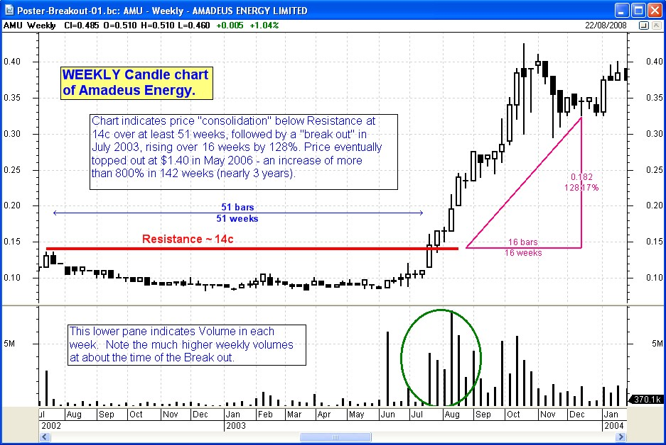
Price Break Out
Notes:
The price breakout
This is a strategy that can be very rewarding, but which might take a little more time to implement.
Earlier in this slide set we showed this chart, but as a monthly chart. Here is the weekly version, and we can see more clearly how the price base consolidation panned out through early 2003, and then the break out in July and with much higher volumes. The higher volumes are important because that indicates the higher level of interest by market participants. Note that the share price raced from the break out for about 14 weeks before pausing. So spotting this in week #1 or #2 would still be profitable.

Slide 51
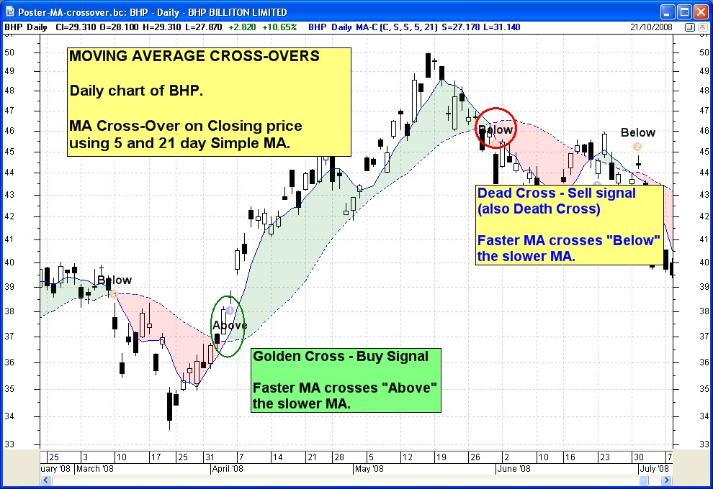
Moving Average Cross-over
Notes:
Moving Average Cross-overs
Here is a strategy that many people follow, and which the experts say is clearly not profitable — perhaps they say that to warn the beginners and encourage research and back-testing before committing.
On this daily chart we are using the 5 and 21 day Moving Averages. And the point at which they cross each other are potential triggers for a buy or sell action.

Slide 52
Some successful strategies
These are in use by some successful traders:
Use the MACD and the RSI indicators.
Look for RSI divergence against
the share price.
Use Stochastic indicator and
Directional Movement (ADX)
to give joint signals.
Caution:- Not guaranteed!!
Tip!
X
Notes:
Two more samples
Here are two more sample strategies.

Slide 53
Some more strategies
Note: None of these can be guaranteed!!
Takeover target speculation
Momentum trading
Position trading
Swing trading
Dividend stripping
IPOs
Hedging
Advanced!
X
Notes:
And some more...

Slide 54
These slides can be
emailed to you.
Please leave
your details
(or send us an email).
Notes:
For anyone viewing these slides at the annual Expo events, or at an ATAA Chapter meeting, this set of slides can be emailed to you (as well as notification of upcoming ATAA meetings and events).

Slide 55
Isn't this gambling?
Some people think that
share trading is just gambling?
Without a proper trading plan and
trading strategy then maybe it is.
Sensible risk and money management
make a very big difference.
But if you have a proper, proven and tested plan,
then it is actually calculated risk taking.
Compare with other professions:
  farming, retail business, catering,
  tourist trade, tradesman, handy man, etc.
Notes:
Gambling?
This question is often considered. Is share market investing gambling or not?
The points on this slide should put aside any considerations that it is like gambling. It is actually quite different because there is a degree of skill and knowledge involved in sensible share market investing.

Slide 56
Trading — Final Tips
Watch out for:
Use a stop loss!
Low liquidity
Watch diligently
(don't take your eyes off the ball)
Retracements
Sucker rallies
Profit takers
The 3-period pause in a rally
Tips!
X
Notes:
Final Tips
Here are some final tips.
Readers are encouraged to research each of these topics elsewhere.

Slide 57
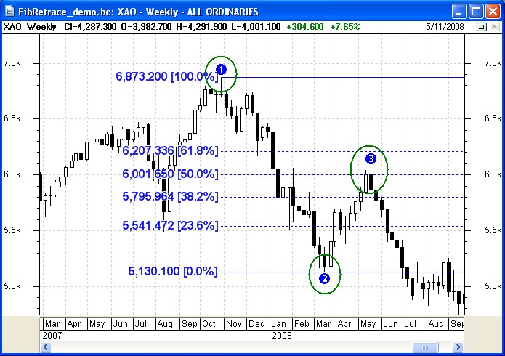
Fibonacci Retracement
X
Notes:
Fibonacci
This is considered a part of the broad field of technical analysis, even if it is not used by many technical analysts.
Readers should seek more information on this topic, as it is a little difficult to try to summarise it meaningfully here.

Slide 58
Use good charting software
If you use a basic charting tool, then the information might be limited to the basics
Use a better tool for greater flexibility and more informative results.
Notes:
Charting software
Some people might underestimate the importance and value of using a good charting tool to help with making investing and trading decisions.
A good tool can not only provide better answers faster, but can also be a joy to use.
There are huge differences between the products in the full range of charting tools.

Slide 59
Charting software – key features
Data — Easy access to download data
Price charts in various time frames
Intraday data (optional)
Indicators – draw them on the chart
Watchlists – several lists of stocks to
easily keep an eye on them
Scans – Specify selection criteria, and
scan the data for stocks that match the criteria
Line studies and annotations on the chart
Notes:
Key features
Here is a list of most of the key features of charting tools that one should consider.

Slide 60
Technical Analysis is: . . .
Price charts and chart patterns
Candlestick (or bar) charts and patterns
Chart Indicators
  Moving Average, MACD, RSI, P-SAR, etc.
Numeric (computational) analysis
Specialist topics:
  Fibonacci, Elliott Wave, W.D.Gann
Using charting software
Notes:
Summary
So, to summarise, the broad subject of technical analysis comprises these major headings.

Slide 61
Technical Analysis is very useful!
Financial market price charts
summarise the underlying
opinions and emotions
of market participants.
Every chart tells a story.
It pays to understand the
stories in the price charts.
*** The End ***
Notes:
Technical Analysis is useful
And technical analysis is very useful for the reason spelt out on this slide.

Slide 62
These slides can be
emailed to you.
Please leave
your details
(or send us an email).
Notes:
For anyone viewing these slides at the annual Expo events, or at an ATAA Chapter meeting, this set of slides can be emailed to you (as well as notification of upcoming ATAA meetings and events).

Slide 63
THE END
Thank you
See free stuff here:
www.robertbrain.com/free
www.robertbrain.com
or phone: 0438 355 910

