Slide 1
COMPLETE THIS WELL
KNOWN PHRASE OR SAYING :
“ THE
TREND IS . . . .”

Slide 2
“ THE
TREND IS YOUR FRIEND”

Slide 3
FINDING
FRIENDS
(The Journey Continues . . . . )
Des Bleakley – BullCharts User Group
Wed 15th March 2017
BCUG Webinar – Wed 29th March 2017

Slide 4
AGENDA
WHAT AM I AFTER?
SIMPLE INDICATORS TO HELP
IDENTIFYING TRENDS
SELECTING FRIENDLY, TRENDY UNIVERSE
DEFINING STRATEGY
MEASURING RESULTS
ALTERNATIVE STRATEGIES
QUESTIONS

Slide 5
WHAT AM I AFTER?
Trend trading
Identify trending stocks
Ride the middle of the trend
Get in early/late enough
Get out early/late enough
Use BullCharts to assist
Hopefully better decisions & outcomes

Slide 6
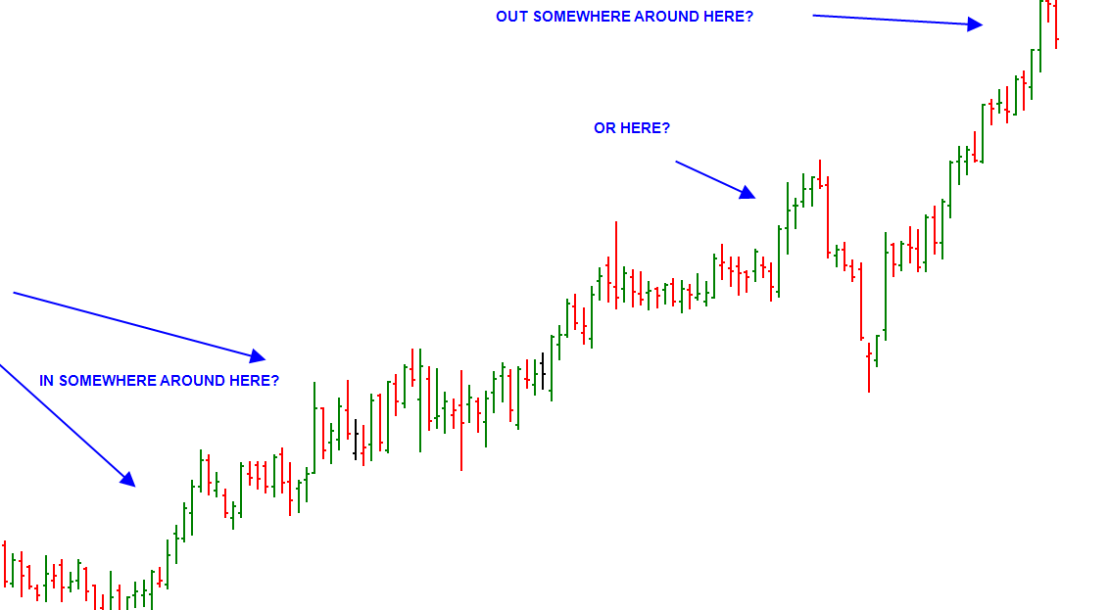
CATCH THE TREND

Slide 7
IN THE BEGINNING
Plot chart
Draw lines and indicators
Develop SMACD
How are my own shares travelling?
  As a trend
  As an investment / trade
Hence HELD indicator
And PROFIT indicator
SIMPLE TO START WITH

Slide 8
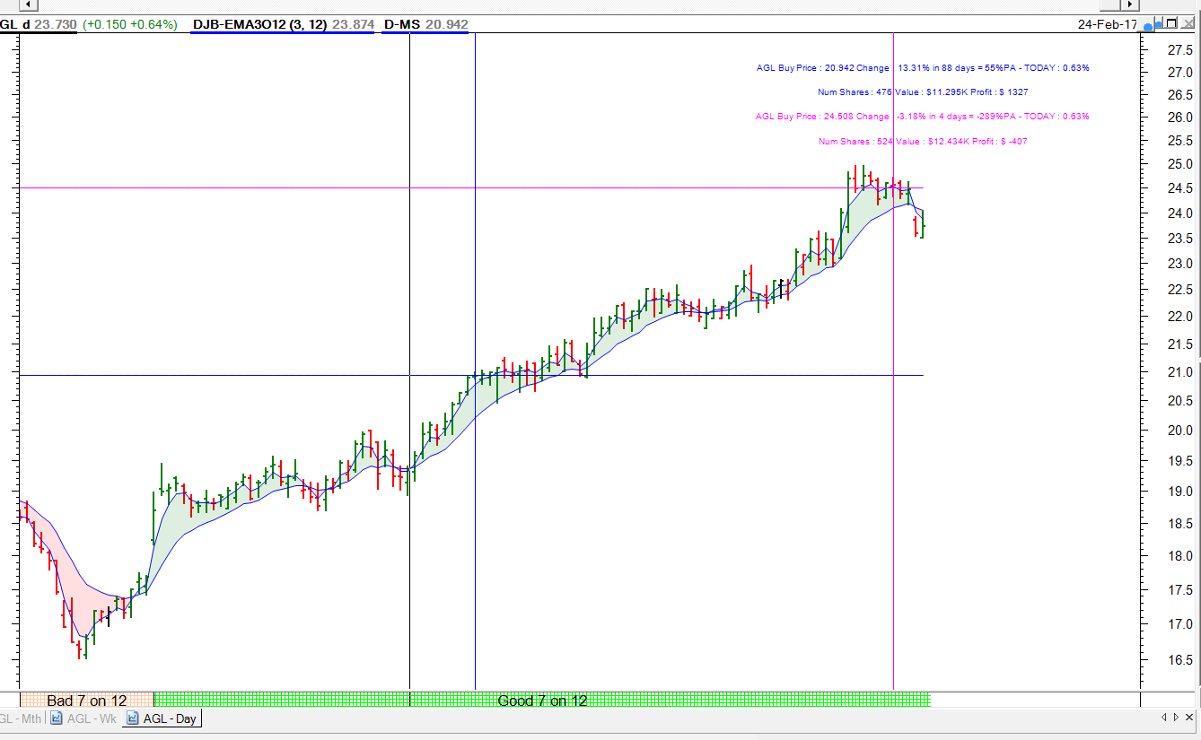
How is this share travelling?

Slide 9
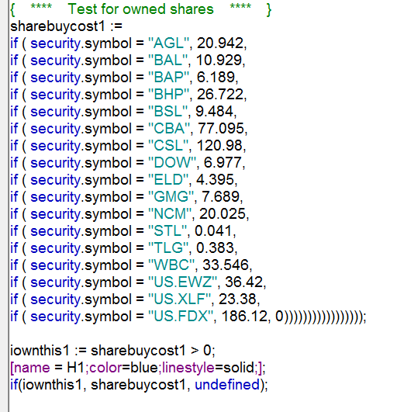
Bull Script for HELD

Slide 10
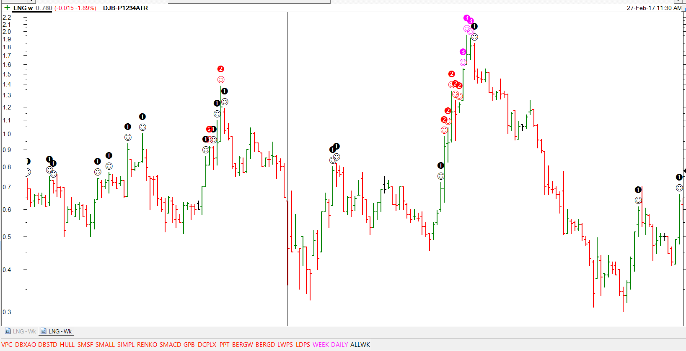
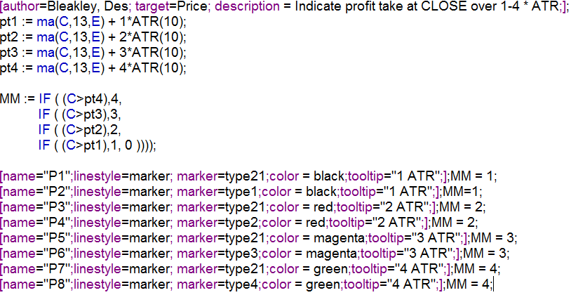
Can I take a quick Profit?

Slide 11
TRENDING
I like 7 on 12 EMA – personal preference
Trade with Trend
  Monthly
  Weekly
  Daily
Use BC Workspace to help visual identification
Update spreadsheet Trend Table

Slide 12
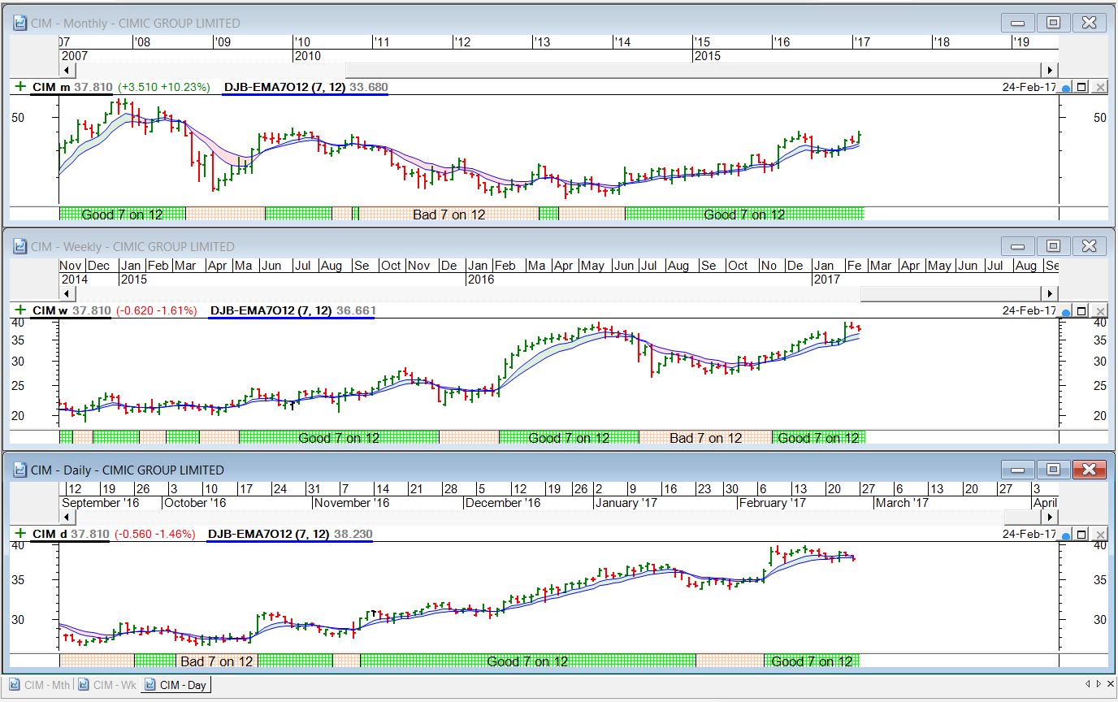
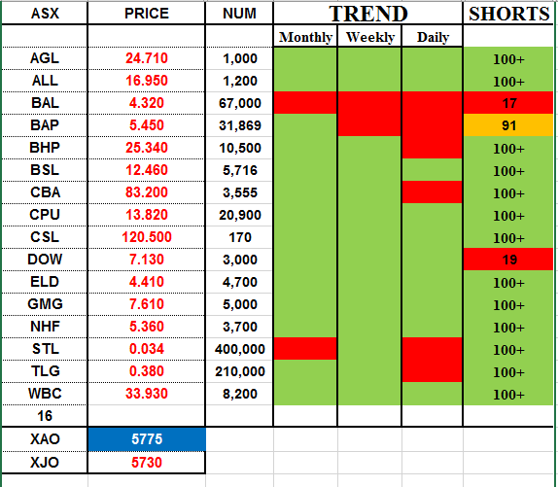
TREND TABLE

Slide 13
Define Trending Universe
ASX 300 starting point
Throw out stocks which are not trending on all of Monthly, Weekly, Daily
  Vary length of trend - 1 period? 4 period?
Brings it down to about 50 stocks
Choose entry strategy (New High chosen here)
Choose exit strategy (7 on 12 EMA chosen)
Put it onto the chart & ponder

Slide 14
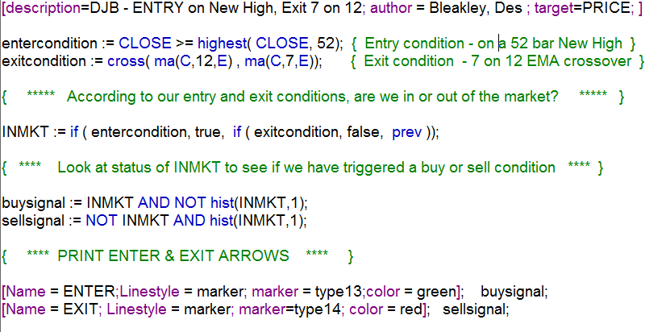
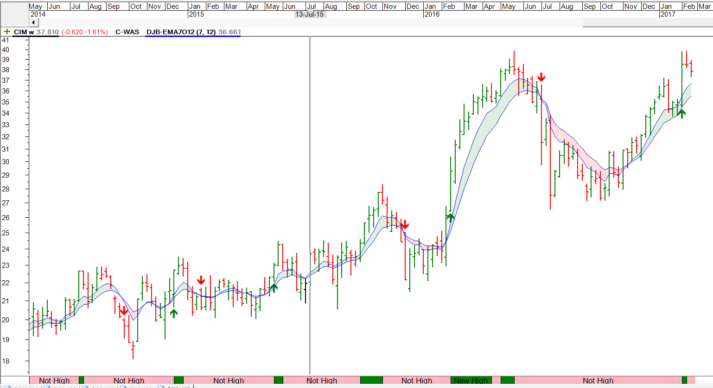
PONDER – Mmmm?

Slide 15
USE THIS AS SCAN ON UNIVERSE
50 stocks comes down to around 10 or less
Improvements?
  Apply entry filter (XAO trending)
  Tighten exit if XAO turns down
  Try different exits (ATR)
Collect statistics on wins & losses
  Buy price
  Sell price
  Profit / loss
  Win / Loss ratio
  Draw Down
  Factor ( Win % * Profit Ratio )
  Volume factor

Slide 16
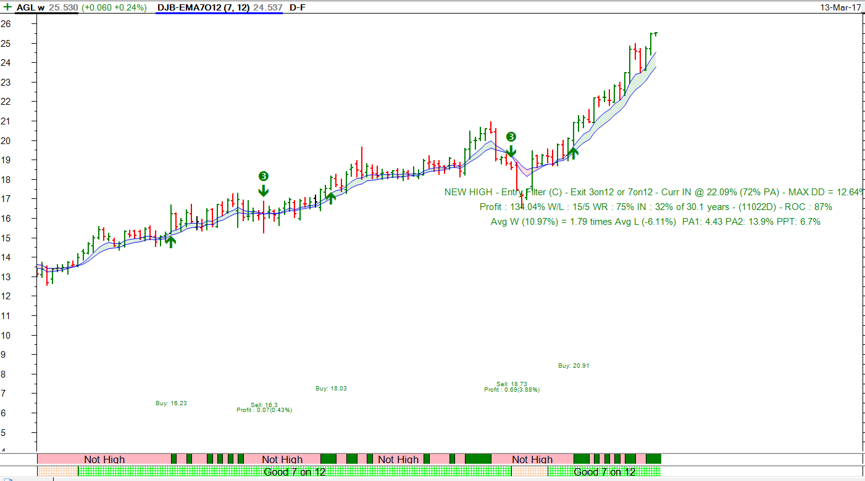
Example – New High Entry with XAO entry filter & XAO exit filter - 3 on 12 or 7 on 12

Slide 17
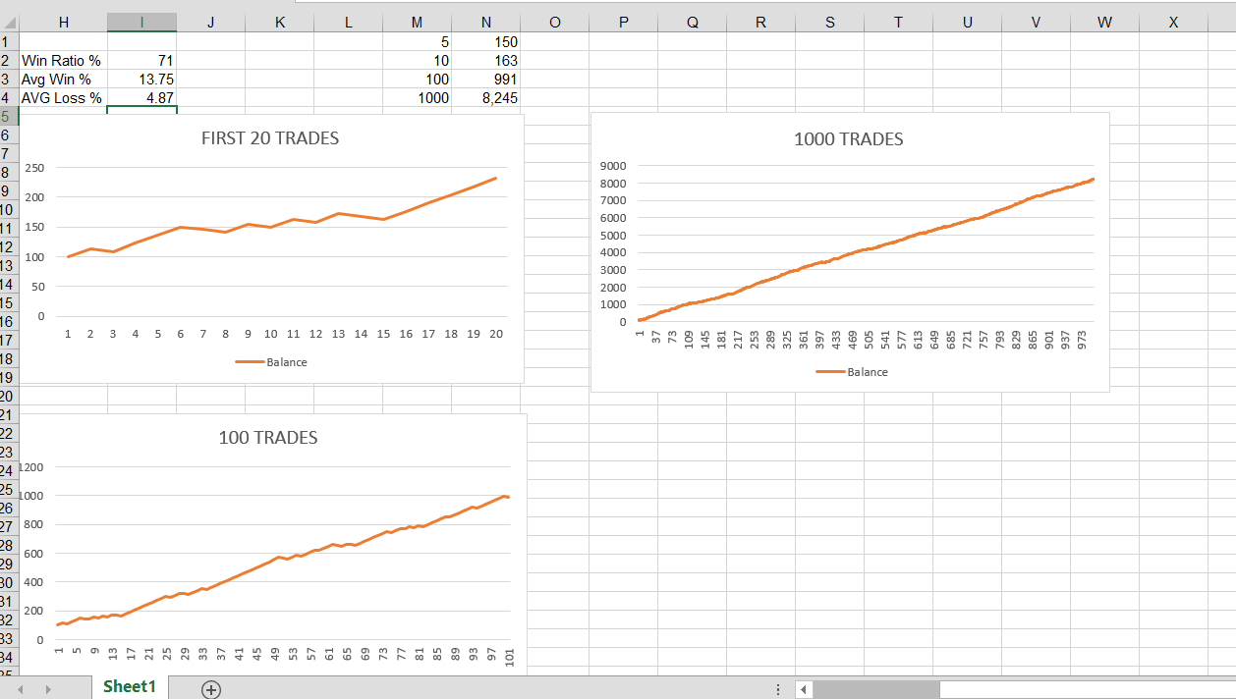
BUT – Is this a good result – is it sustainable over the long term?
(Thank you Kevin Saunders – ATAA – 9 March 2017)

Slide 18
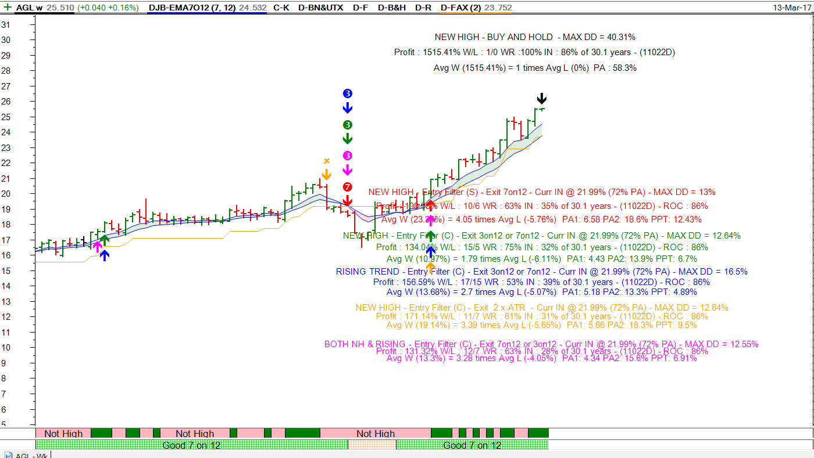
Six Different Strategies
(Busy Slide)

Slide 19
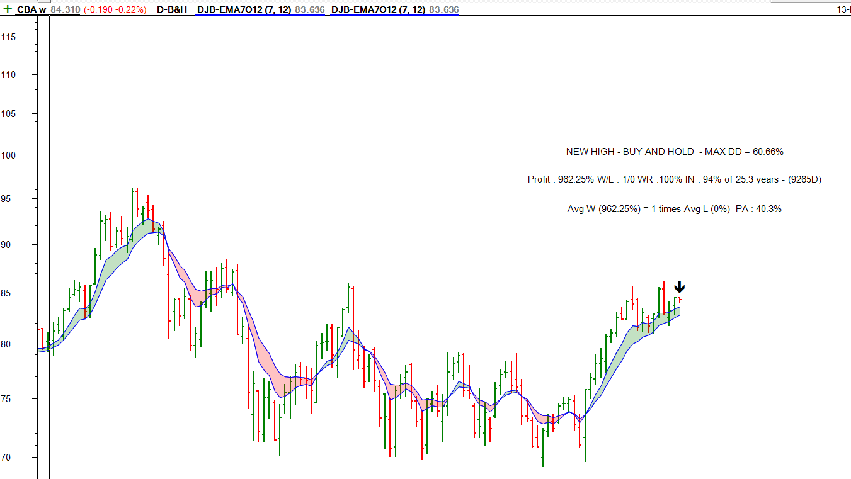
Simplest Strategy
(Buy & Hold)

Slide 20
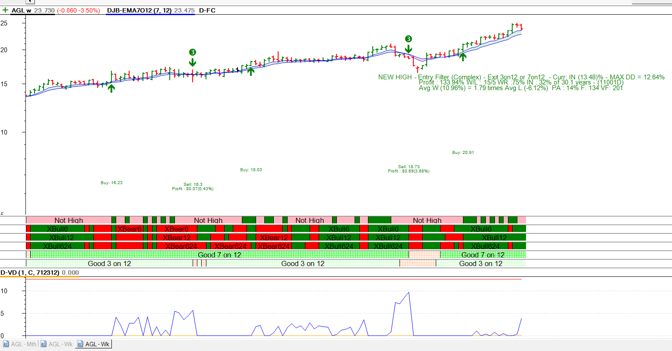
WHAT ABOUT DRAWDOWN?

Slide 21
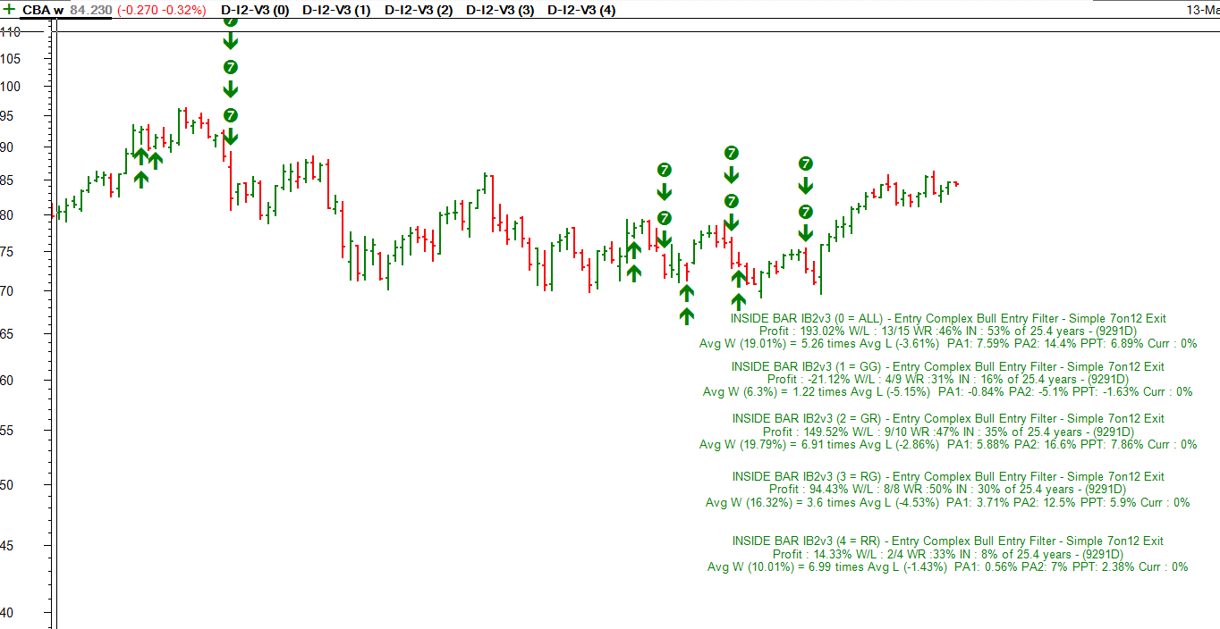
HOW DO INSIDE BARS LOOK?
This is two bar analysis.

Slide 22
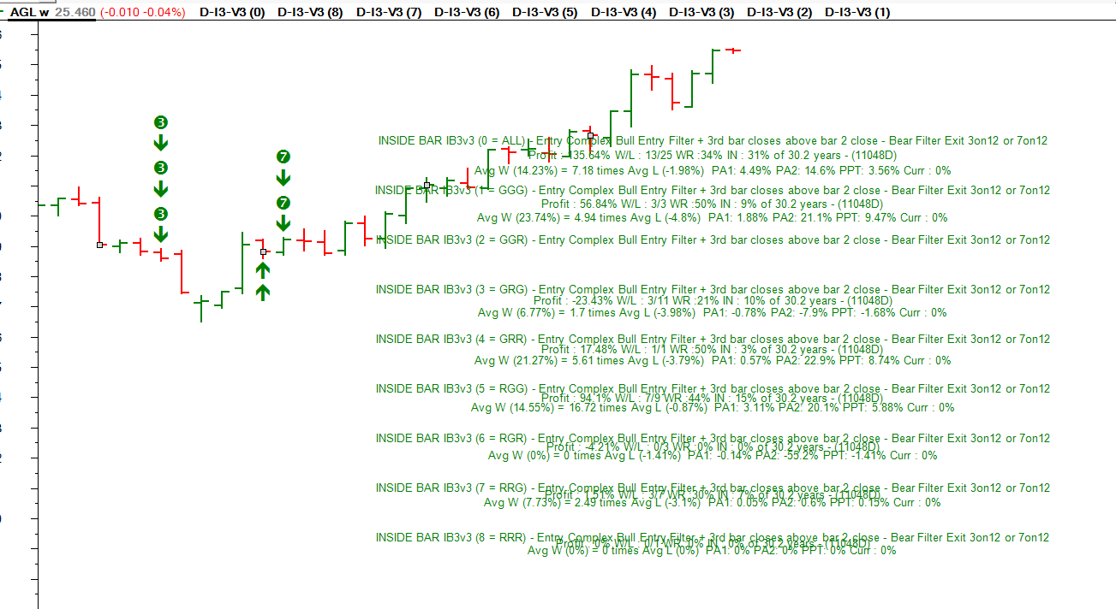
HOW DO INSIDE BARS LOOK?
This is three bar analysis.

Slide 23
SUMMARY
Alternative Strategies
BUY & HOLD?
Different Universes of stocks
Try different Enters & exits
Which is best?
Inside Bars ??
The Quest Continues - suggestions
QUESTIONS?

